Slide 1
Prediction of a suitable location for opening a restaurant in Mumbai

Slide 2
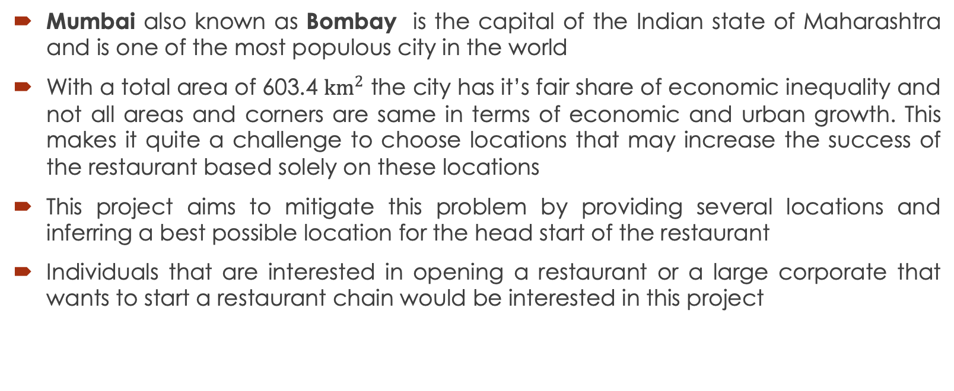
Introduction
Mumbai also known as Bombay is the capital of the Indian state of Maharashtra and is one of the most populous city in the world
With a total area of 603.4 ${km}^{2}$ the city has it’s fair share of economic inequality and not all areas and corners are same in terms of economic and urban growth. This makes it quite a challenge to choose locations that may increase the success of the restaurant based solely on these locations
This project aims to mitigate this problem by providing several locations and inferring a best possible location for the head start of the restaurant
Individuals that are interested in opening a restaurant or a large corporate that wants to start a restaurant chain would be interested in this project

Slide 3
Data acquisition and cleaning
For the Project, we first need to have a data that shows all the Suburban and Urban areas in Mumbai along with their respective postal codes which can be found here
The data was scraped using BeautifulSoup after which through a series of steps the data was arranged in the tabular form wherein there were two columns of postal codes and neighborhoods respectively
In total we were able to scrape 50 Neighborhoods along with their respective postal codes wherein all the areas were within the suburban and urban region of Mumbai

Slide 4
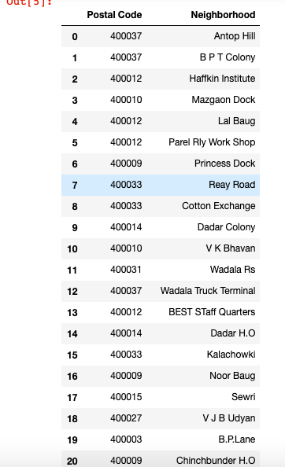
Fig 1: Table containing Postal Codes and Neighborhoods

Slide 5
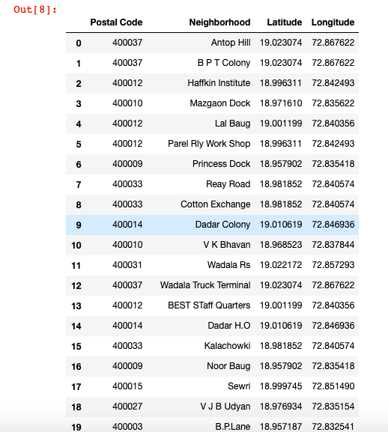
Adding Features
After the data has been cleansed, we need to find longitude and latitude for each of our neighbors in order to carry out our analysis which can easily be obtained by using various geocoding APIs which are out there but for this experiment I have decided to use OpenCage geocoding API.
So, by using the appropriate code and passing down the keys I was able to obtain the list which contains both longitude and latitude.
Fig 2: Latitude and Longitude appended to base Table

Slide 6
Nearby Values
In order to find the suitable location for a restaurant we need to first define our ideal location. An ideal location for our restaurant startup would be where we can expect customers that have come primarily to eat in the neighborhood
Since our restaurant is new, we can’t expect our customers to go out of their way and try it out but what we can expect is that if customers are in the neighborhood to eat at their usual places and they get to see our restaurant then they may be tempted to try it out
So our primary objective should be to find neighborhoods that has food related venues as their most common venues
For this, we need to first find all the nearby venues for each neighborhood. This was done using Foursquare API by defining a function. By passing all the required credentials of the API in the function we are able to find all the nearby venues of each neighborhood with limit set to 100 venues along with their longitude and latitude followed by the category under which they fall

Slide 7
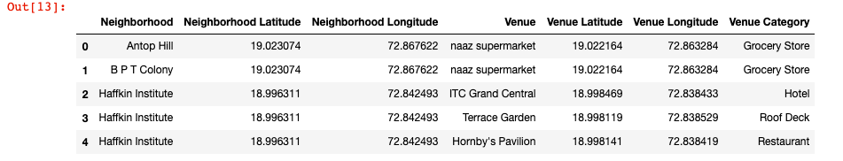
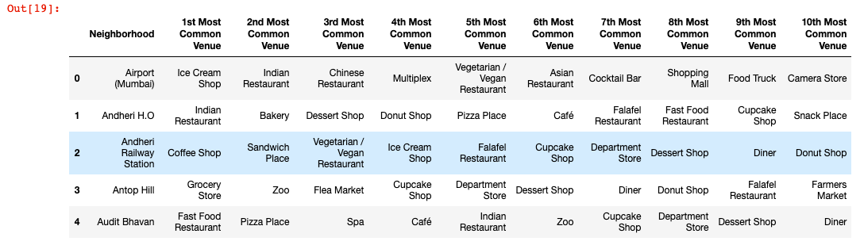
Fig 3: Nearby Venues of all neighborhoods
After this, we can group each neighborhood and count the total number of venue category under each of these neighborhoods followed by finding out the frequency of each this category with which they occur. With this, the top 10 most common venues was found out for each neighborhood.
Fig 4: Most common venue for each neighborhood

Slide 8
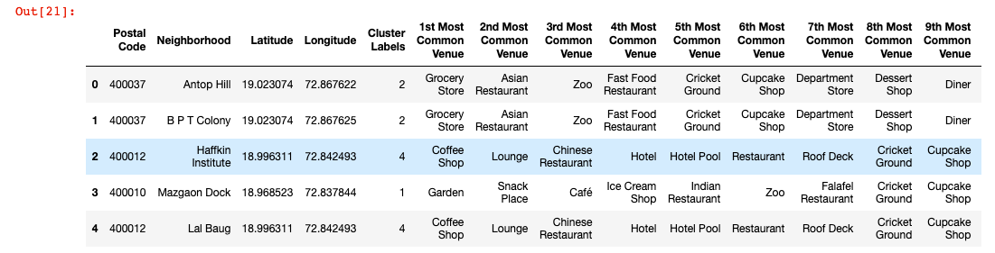
Clustering
After finding out the top 10 venues for each neighborhood, we can cluster them using K-means and through each cluster point we can visualize these venues and try to find out the most optimum location based on features that each location offers and thereby narrowing down our search
Fig 5:Setting up of Cluster labels for clustering of neighborhoods

Slide 9
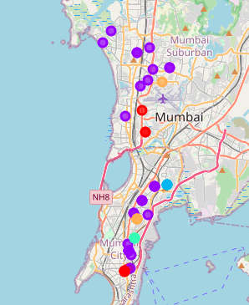
Fig 6: Map containing all cluster points

Slide 10
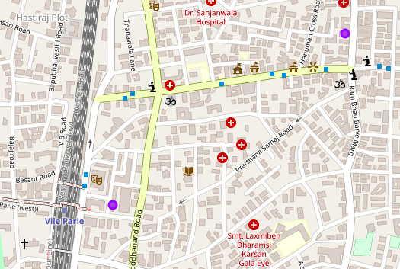
Result
Now since we have a clear map of all cluster points, it has now come down to observation and having a basic geographic knowledge about locations thereby aiming for factors that we would need in order to make our restaurant a success.
Through these observations we were able to find the factors that our location offered and on that basis we can infer ‘Vile Parle’ as a suitable location for starting up our restaurant.
Fig 7: Vile Parle Location Cluster points
Fig 8:Common venues under this Cluster Points

Slide 11
Conclusion
Thus, based on analysis and then further narrowing the results down based on several factors. I am able to infer that ‘Vile Parle’ might be a suitable location if one wishes to start a restaurant since it does provides an opportunity to grow and does looks promising

